Slide 1

DATA ANALYTICS PROJECT
NETFLIX
PROJECT TEAM
DATA ANALYSIS & INTERACTIVE DASHBOARD
Team member 1 : Dev Panchal
A data-driven view of Netflix's content catalogue
Team member 2 : Jeel Mistry
Team member 3 : Neel Langaliya
Team member 4 : Parth Balar
Team member 5 : Jessica patel
Sub-code : 1IT502
Group : Team analyst
Subject / Faculty : Krina Mam / Niyati Mam
RAW DATA › CLEANING › DASHBOARD › INSIGHTS
01 / 07
Notes:
Start the slideshow and click the embedded Netflix intro video to play it. Depending on the PowerPoint version and playback settings, automatic playback may need to be enabled manually. Replace all team placeholders before presenting. Then introduce the workflow: raw data, cleaning, dashboard, insights.

Slide 2
NETFLIX DATA ANALYTICS
NETFLIX CATALOGUE • DATA-DRIVEN STORY
01 | Understanding the Raw Dataset
RECORDS
FIELDS
EXACT DUPLICATES
RELEASE YEARS
8,807
12
0
1925–2021
Rows in original CSV
Columns available
No full-row duplicates
Range in dataset
DATA QUALITY: MISSING VALUES
KEY FIELDS
director
2,634
Field
Meaning
country
831
type
Movie or TV Show
cast
825
release_year
Original release year
10
country
Production country/countries
date_added
date_added
Date added to catalogue
rating
4
rating / duration
Audience rating / length
duration
3
listed_in
Genre/category labels
ACADEMIC PROJECT | Dataset: netflix_titles.csv
02 / 07
Notes:
The dataset contains 8,807 records and 12 columns. Missing values are concentrated in director, cast and country. There are no exact duplicate rows in the original file. Multi-value fields such as country and genre require careful interpretation.

Slide 3
NETFLIX DATA ANALYTICS
NETFLIX CATALOGUE • DATA-DRIVEN STORY
02 | Data Cleaning & Transformation
CLEANING SHOULD IMPROVE CONSISTENCY WITHOUT DESTROYING INFORMATION.
TRIM TEXT
PARSE DATES
01
02
Remove leading/trailing whitespace in text fields.
Convert date_added into a proper date field; preserve original values.
DURATION FEATURES
MISSING VALUES
03
Extract numeric length and unit (minutes / seasons).
04
Profile missingness; avoid blindly filling unknown cast, country or director.
FLAG EXCEPTIONS
VALIDATE
05
Review 3 records where rating appears to contain a duration.
06
Recheck types, missing values, duplicates and row counts.
Important: preserve the raw file; document each transformation and compare before/after quality metrics.
ACADEMIC PROJECT | Dataset: netflix_titles.csv
03 / 07
Notes:
Explain each cleaning rule and why the raw file should be preserved. The three suspicious rating/duration records are flagged for review rather than automatically modified. Avoid claiming an operation was completed unless you ran it.

Slide 4
NETFLIX DATA ANALYTICS
NETFLIX CATALOGUE • DATA-DRIVEN STORY
03 | Final Dataset: Analysis-Ready Structure
BASELINE RECORDS
ORIGINAL FIELDS
FULL-ROW DUPLICATES
DERIVED FEATURES
8,807
12
0
2
Retain rows unless justified
Preserve source columns
Baseline validation
Date + duration fields
SUGGESTED FINAL SCHEMA
VALIDATION CHECKLIST
Original field
Use in analysis
□ Confirm raw row count is preserved
□ Trim and standardize text consistently
□ Parse dates and duration without overwriting originals
□ Review suspicious rating/duration records
□ Recalculate missing values after cleaning
□ Save a separate cleaned dataset
type
Compare Movies vs TV Shows
release_year
Explore release-year patterns
date_added
Catalogue addition trend
country
Geographic catalogue distribution
listed_in
Genre/category analysis
duration
Length or seasons after parsing
rating
Content classification
Note: post-cleaning metrics should be filled only after running and validating the cleaning pipeline.
ACADEMIC PROJECT | Dataset: netflix_titles.csv
04 / 07
Notes:
This slide describes the intended analysis-ready structure. Complete the validation checklist after running the cleaning pipeline. Do not report post-cleaning numbers until they have been calculated from the cleaned file.

Slide 5
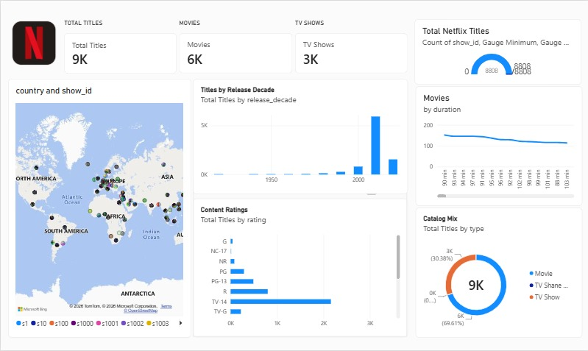
NETFLIX DATA ANALYTICS
NETFLIX CATALOGUE • DATA-DRIVEN STORY
04 | Netflix Dashboard Overview
05 / 07
Notes:
This dashboard slide is an illustrative layout built from verified dataset counts. If you already have a dashboard, replace this mockup with a screenshot of your actual dashboard and retain only visuals that exist in it.

Slide 6
NETFLIX DATA ANALYTICS
NETFLIX CATALOGUE • DATA-DRIVEN STORY
05 | Dashboard Observations & Insights
01
MOVIES DOMINATE
6,131 Movies vs 2,676 TV Shows; movies make up 69.6% of catalogue titles.
02
RECENT RELEASE YEARS
2017–2020 are among the most represented release years; 2018 leads with 1,147 titles.
03
US & INDIA LEAD
Country labels: United States 3,689; India 1,046. Co-productions can count in multiple countries.
04
DRAMA & INTERNATIONAL
International Movies (2,752) and Dramas (2,427) are the most frequent genre labels.
05
RATING MIX
TV-MA (3,207) and TV-14 (2,160) are the most frequent content ratings.
These are catalogue metadata findings—not proof of viewing popularity, revenue, or audience satisfaction.
ACADEMIC PROJECT | Dataset: netflix_titles.csv
06 / 07
Notes:
Key observations: Movies are 69.6% of records; 2018 has the highest count by release year; United States and India lead the split country labels; International Movies and Dramas are frequent genres; TV-MA and TV-14 lead ratings. Country and genre counts overlap.

Slide 7
NETFLIX DATA ANALYTICS
NETFLIX CATALOGUE • DATA-DRIVEN STORY
06 | Recommendations for Netflix
01 Improve metadata completeness
02 Compare content portfolios
Prioritize director, cast and country metadata quality; track completeness rate.
Review movie/TV balance by country and genre before making acquisition decisions.
03 Track catalogue additions
04 Add business outcome data
Monitor date_added trends separately from release_year trends.
Combine catalogue metadata with viewing hours, completion, retention and cost data.
CONCLUSION
A cleaned, well-structured catalogue makes Netflix's content mix easier to explore. The next step is to connect metadata patterns to audience and business performance before making high-impact decisions.
ACADEMIC PROJECT | Dataset: netflix_titles.csv
07 / 07
Notes:
Recommend metadata quality tracking, portfolio comparisons, catalogue-addition monitoring, and linking metadata to viewing/business outcomes. This dataset alone does not contain watch time, revenue, subscriber or retention metrics. End with questions.

Slide 8
Thank You!

